Slide 1

FoxTabs
A member of the VFP Solution Explorer IDE productivity suite
Scott Scovell
Software Architect
Talman Pty Ltd

Slide 2

Introduction
Manage multiple IDE editing windows.
Manage multiple IDE tool windows.
Standardise the IDE with other widely used development environments.
Part of VFP Solution Explorer IDE suite.

Slide 3
Feature Set
Toolbar tabs for all open IDE windows.
Windows message event driven.
VS.NET style tabs.
Mouse click window activation to switch between IDE windows.
Desktop tab to hide all windows.
Tab context menus allowing close and save functionality. (including close all/save all)
Configurable appearance, number, and size of tab controls.
Menu to display list of all open windows.
Single file deployment.

Slide 4
Demonstration

Slide 5
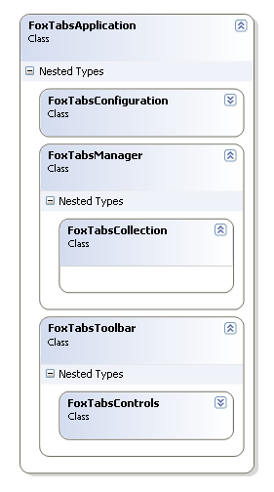
Architecture

Slide 6
Binding to Windows Message Events
Window message events cycle
  WM_CREATE
  WM_SHOWWINDOW
  WM_SETTEXT
  WM_SETFOCUS
  WM_DESTROY
Listen for all WM_CREATE notifications
Bind to WM_SHOWWINDOW for that hWnd
Test hWnd meets eligibility conditions
Bind to other events for that hWnd.
TIP: Use Spy++ to discover / investigate Windows message events

Slide 7
FoxTab objects & FoxTab Controls
FoxTab object instance for each IDE window.
  Managing hWnd’s, Window title text, content types.
FoxTab UI control for each FoxTab object.
  Presentation of managed IDE window properties.
Responding to FoxTab UI generated events:
  Activating windows
  Hiding windows
  Closing windows
  Saving windows
Avoid event recursion by using nFlag = 4 with BindEvent().

Slide 8
Code walkthrough
Application singleton class.
Configuration block.
Loading existing IDE windows on start up
  Adding a FoxTab object to the collection.
  Binding to Windows message events.
  Adding a UI control to the toolbar.
Windows messages event handler
  Listen for all WM_CREATE notifications
  Bind to WM_SHOWWINDOW for that hWnd
  Test hWnd meets eligibility conditions
  Bind to other events for that hWnd
Responding to FoxTab UI generated events:
  Activating windows
  Hiding windows
  Closing windows
  Saving windows
FoxTabs options

Slide 9
The Future
IDE Window event add-ins
  User code that gets executed when the registered window event occurs.
VFP Solution Explorer integration features
  Extended FoxTabs context menu functionality.
  Most recently used windows.
  Restore windows when opening a solution.
  …
Community feature requests
  www.vfpsolutionexplorer.com forum

Slide 10
Thankyou
Don’t forget to register at www.vfpsolutionexplorer.com
  Download FoxTabs source code
  Check for the latest news
  Participate in the forums
  Request additional features
  Report bugs
My details
  Scott Scovell
  Email: ss@talman.com.au
  Skype: ss.talman

